Slide 1

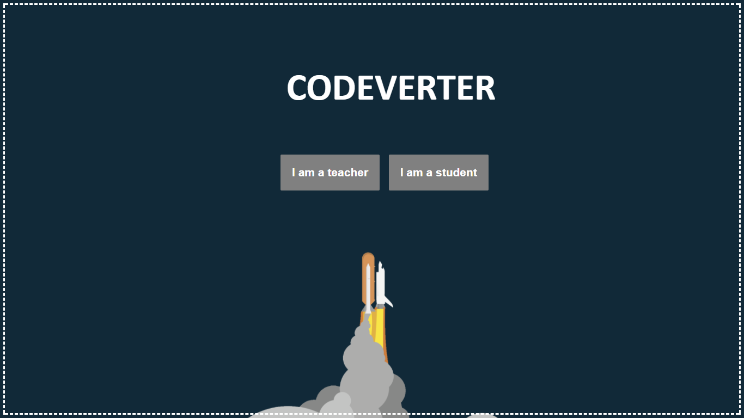
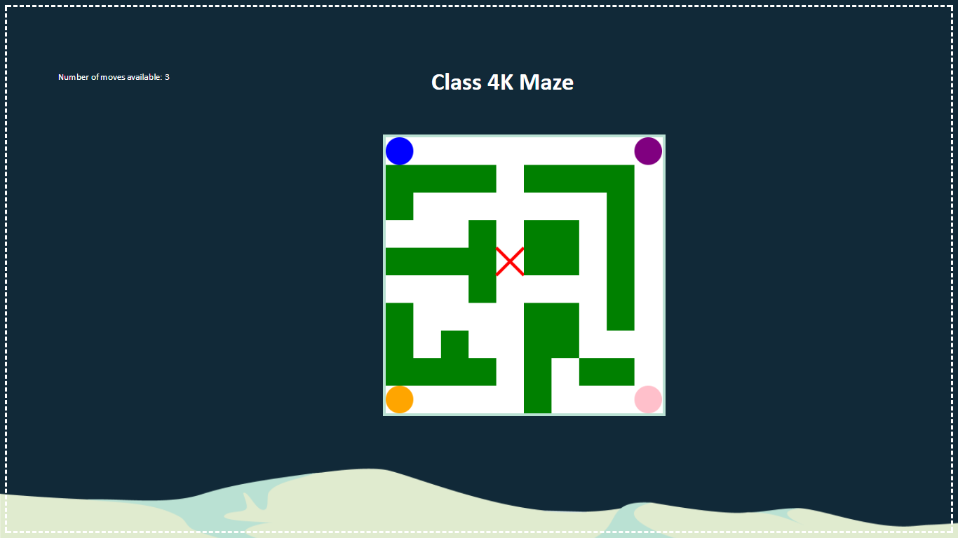

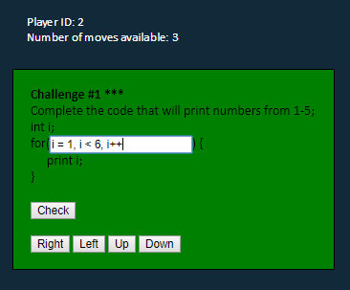
CODEVERTER
The problem:
In some shape or form, technological advancements shape and control just about every aspect of our lives today. As a result children today are growing up in a very different world than previous generations. Currently in Australia more than 90% of the workforce will need digital skills to perform their roles and in the next 2-5 years 60% of students will be studying or training for positions that will become largely automated. Thus in this digital age it’s important for students to start learning how to program from a younger age.
However, when trying to do so, we are faced with a few challenges. It’s not easy to get young people to not only learn such complex concepts, but also get them to take interest in programming. And, not all teachers are equipped with the skills to teach programming. There needs to be a resource that inexperienced teachers can use to aid the classroom, that will engage primary school aged students.
Our solution:
We started off with the idea of making a web application that students can use to effectively “Google” search coding problems, with search results returning functional code. As we developed this concept further, we decided to steer more towards a game-based system that would also teach students programming concepts.
Our final design is a web based application to be used in ICT classrooms for students in years 3 through to 6. As the primary idea is to make the classroom environment an engaging and social learning environment, Codeverter does this through many different types of games that classes can play either individually or in groups, but always competing against either the rest of the class, or another class.
Through the design process, we paper prototyped and tested a sample of teachers and students to get their feedback on how to proceed and improve the concept.
For our interactive prototype, we have programmed the Maze game, for up to 4 players, to simulate the social and learning aspect of the application as this is what is innovative about the concept. We have also prototyped and tested the Space game, and decided to make this the main theme of the website.
As this is only the prototype and proof of concept, the next step in the process would be to develop more of the games, make the games more suitable for more players, and develop more programming questions for the students to practise on.
Another feature we would add to the application would be a levelling and leaderboard system, where students can get “Experience” from games which go towards levelling up, which comes with rewards. Having a leaderboard system will encourage students to do more problems in their own time in order to get higher on the leaderboard.
For the prototype, we’ve left out a secure login system, and have simple Teacher and Student portals for testing our concept.
Teachers are directed to a screen that shows them the lesson plan for the session, and allows them to choose from two games, a Maze game and a Spaceship game.
The Teacher screen for this prototype will show a large Maze map for the duration of the game, and up to 4 players can join the game in a race to the centre of the map!
The Student screens give students a
range of coding problems they must
solve in order to get “moves” which
allow them to move around the maze
in a race to the centre of the board!
There will be more problems when the
program is further developed, but for
the prototype, we have chosen to only
include one problem as this sufficiently
demonstrates the concept in order to
test the social aspect of the games.

